Slide 1
Benefits of Physical Activity

Slide 2
Learning Objectives
Explain the molecular differences between simple sugars and fiber including the differences in how our bodies metabolize these carbohydrates.
Using Atwater rules, predict the number of calories in a gram of food.
Understand and explain the differences between refined and unrefined foods and how this affects energy extraction.
Practice using a nutritional assessment tool and consider the validity and biases of both 24h recall and food frequency questionnaires in understanding diet composition and caloric intake.

Slide 3
Benefits of Physical Exercise
Flexibility
Strength
Mood
Cardiovascular health
Benefits at all BMI categories
Blair SN, Kohl HW, Paffenbarger RS, Clark DG, Cooper KH, Gibbons LW. Physical fitness and all-cause mortality. A prospective study of healthy men and women. JAMA. 1989; 262: 2395–401. doi: 10.1001/jama.1989.03430170057028.

Slide 4
Physical Activity Independently Reduces Mortality Risk
Lear, S. A. et al. The effect of physical activity on mortality and cardiovascular disease in 130 000 people from 17 high-income, middle-income, and low-income countries: the PURE study. Lancet 6736, 1–12 (2017).

Slide 5
Molecular Nutrition
Does what we eat matter?

Slide 6
Why do we eat?
Need to ingest things our bodies cannot make
Essential Amino Acids (10/20 are essential)
Minerals
Vitamins
Essential Fats (ω3 and ω6 fatty acids)
Need fuel
Macronutrients like Carbohydrates, Proteins and Fat
Reduce stress, enhance mood

Slide 7
Differences Between Macronutrients
Energy Content
Lipids have high caloric content
Proteins and fiber are poorly metabolized
Satiety
Protein is the most satiating
Macronutrient | Atwater Factor | Digestion Efficiency | Metabolizable
Lipids | 9 kcal/g | 86% | 7.8 kcal/g
Proteins | 4 kcal/g | 77% | 3.1 kcal/g
Carbohydrates | 4 kcal/g | 95% | 4.0 kcal/g
Fiber | 2 kcal/g | 61% | 1.2 kcal/g

Slide 8
The Effects of Refining on Energy Extraction
Refining removes
Micronutrients
Fiber
Makes the refined grain easier for digestive enzymes to access

Slide 9
Macronutrient Density and Feelings of Fullness
How would these diets affect ghrelin signaling?
Notes:
Vegetables would suppress ghrellin more

Slide 10
Digestibility and Energy Extraction
Some foods are difficult to digest (proteins, fiber)
Some foods are easy to digest (sucrose, amino acids)
This is not necessarily a property of the macronutrient, but the food
Cooking can increase the efficiency of digestion
See optional readings article “Eating Cooked Foods Made Us Human”
We do not have digestive enzymes for cellulose

Slide 11
Digestibility Examples

Slide 12
Sugar Sweetened Beverages and HFCS
What do you think might make sugar-sweetened beverages particularly problematic?

Slide 13
How do we measure what people eat?

Slide 14
Methods of Dietary Assessment
Measures of food intake
Food frequency questionnaires (FFQ)
24 hour recalls
Food records
Biochemical indicators
Novel methods
Food Photography

Slide 15
Challenges to measuring dietary intake
Everybody eats!
People are terrible at remembering what they ate
People are terrible at knowing what they ate
Literacy, numeracy, estimation of portions
High correlation between dietary components
Little variation of diet within cultures
Little change over time

Slide 16
Which method did you try?
24 hour recall
Food Frequency Questionnaire
Food photography
In groups, take turns explaining how the method you tried works

Slide 17
Food Frequency Questionnaires
Assess usual intake over a specified time period
Asks about frequency of intake and usual portion size
Low burden on both participants and researchers
Typically captures approx. 100 food types
Specific FFQ screeners exist
NCI fruit and vegetable screener
Dietary fat screener
Sugar-sweetened beverage screener

Slide 19
24 hour recalls
Measures intake for past 24 hours
Individual, group, or online
Multiple pass method
Identifies food type, portion size, timing of meal
Can add contextual information

Slide 20
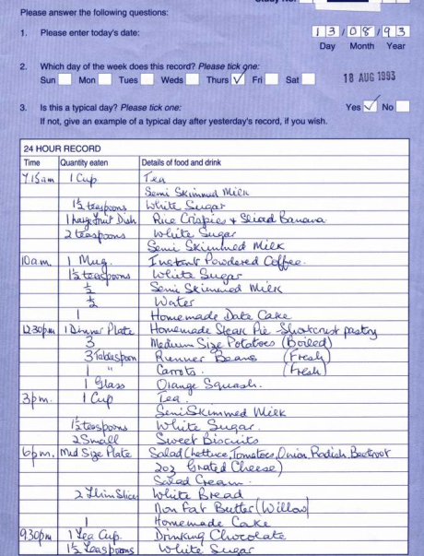
Food Diaries
Detailed meal-by-meal recordings of the types and quantities of food and beverage consumed
Usually 3-7 days are recorded

Slide 21



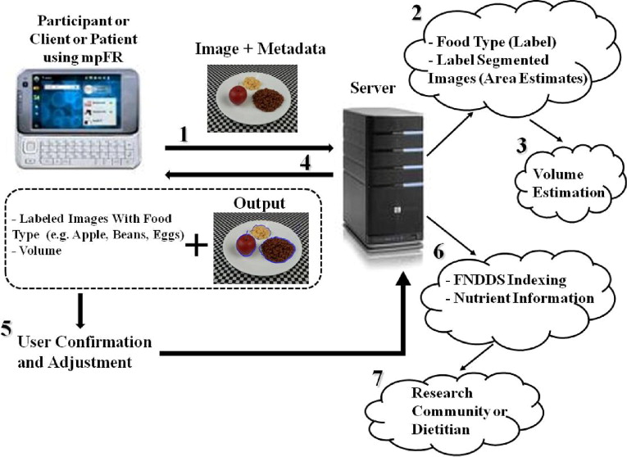
Novel Methods

Slide 22
Talk within your groups about some sources of error with the method you used
Are these problems of bias or accuracy?

Slide 23
How would these impact how someone reports their diet?
Weight status
Dieting status
Quality of diet
Sex/gender
Has diabetes
Education
Socio-economic status
Age
Participants in a nutrition improvement program

Slide 24
Example: Self-Report vs Objective Food Intake
Notes:
In NHANES, 67.3% of women and 58.7% of men did not report physiologically plausible intake

Slide 25
Reliability in Research Contexts
The scientific and medical communities should discontinue reliance on self-reported energy intake
Solutions:
Self-report measures have been compared to biological marker of energy intake.
Correlation between FFQ and biomarker = 21%
Correlation between 24h recall and biomarker = 26%
To correct self-report measures, many people identify what values are biologically implausible
This is not a correct way to identify misreporting!
Bad evidence means that clinicians and health-care professionals cannot respond confidently with evidence-based advice.
Need better objective measures

Slide 26
Learning Objectives
Explain the molecular differences between simple sugars and fiber including the differences in how our bodies metabolize these carbohydrates.
Using Atwater rules, predict the number of calories in a gram of food.
Understand and explain the differences between refined and unrefined foods and how this affects energy extraction.
Practice using a nutritional assessment tool and consider the validity and biases of both 24h recall and food frequency questionnaires in understanding diet composition and caloric intake.

